Slide 1
Project 1: CrayolaDraw
using a list of crayola standard colors
to make an interactive drawing website
https://renaidn.github.io/CrayolaDraw/

Slide 2
Functions
Drawing on canvas
Changing canvas orientation
Changing canvas size
Saving canvas as jpg
Clearing canvas
Copying hex of the current color
Choosing brush
Choosing brush size
Choosing color from the palette given (eyedropper tool imitation)

Slide 3
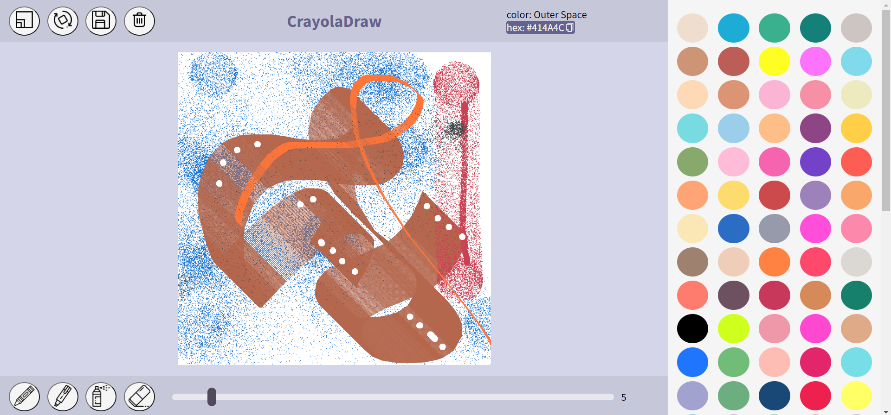

Slide 5
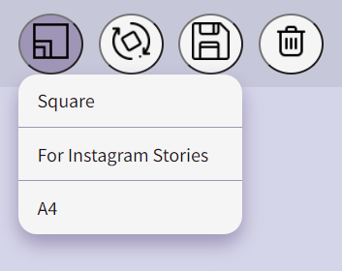
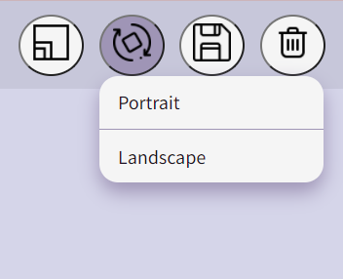
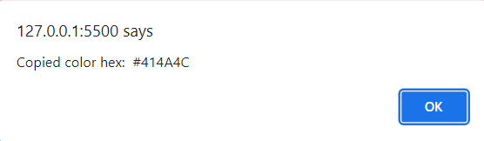
dropdown menu showing when user hovers over button (either artboard resize or artboard orientation adjust)
Alert Window pops up when color hex is copied

Slide 6
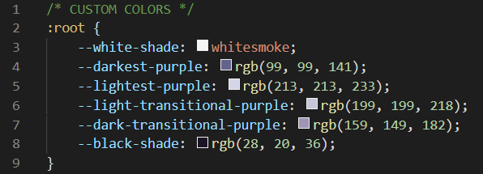
List of little things I found enjoyable about this project
making colors into variables declared in “:root” selector of CSS (makes me feel smart and is generally useful)
interactivity level of the website (though there are some things to add, it doesn’t feel like an incomplete piece to me)
overall aesthetic of the website (prettiest thing I have made so far)
brush textures
lack of text on page

Slide 7
Things to work on / add
Naming things properly from the start (cleaning the code was a painful process)
More functionality / more options / more of everything
Perhaps a guessing game with the colors? (crayola color shade names are fun but I have discovered it quite late into the process)
Responsiveness (it’s not. at all.)
Zooming in / out of canvas
Active brush visual cue
Maybe some other type of visualization for successful color code copy (alert windows are somewhat not aesthetically pleasing)

